Slide 1

E-Raksha: Your Personal Safety Companion with
Real-Time GPS Tracking
Group No. 6
Faizan Mahimkar 21107007
Himanshu Maurya 21107038
Sanchit Patil 21107001
Harshal Patil 21107060
Prof. Rajashri Chaudhari
Project Guide

Slide 2
Abstract
In today's world, women's safety remains a pressing concern, with the need for reliable, real-time solutions to address emergency situations quickly and effectively. This project presents E-Raksha, a comprehensive women safety system combining both software and hardware on an Android platform. It leverages mobile and button cameras for violence detection and criminal face recognition, ensuring proactive responses to dangerous situations. Additionally, the system integrates GPS modules and tags for real-time location sharing, triggered by a hardware button or a smartwatch, allowing users to send distress signals to designated contacts or emergency services.

Slide 3
Introduction
Women's Safety in India: A Growing Concern
In India, women’s safety remains a critical issue, with reports of violence, harassment, and assault continuing to rise. According to the National Crime Records Bureau (NCRB), crimes against women increased by over 7% in 2022, with more than 4.3 lakh cases reported across the country.
Despite government initiatives like panic buttons in public transport and mobile apps, these solutions are largely reactive and require manual activation. Often, they fail to provide the real-time protection necessary during critical situations, especially in remote areas where immediate help is not always available.

Slide 4
Motivation
Why Addressing Women's Safety is Crucial
The motivation for this project comes from the growing number of real-life incidents where women are left vulnerable in unsafe environments, especially when isolated.
While many apps offer safety measures, few combine multiple technologies like violence detection and criminal face recognition in a single system.
Our observations of the limitations of current safety tools, such as delayed response times and limited detection capabilities, pushed us to explore a solution that provides real-time, autonomous protection.

Slide 5
Objectives
To analyze crowd data and identify high-risk areas based on crime statistics.
To identify potential threats or individuals of interest through facial recognition technology.
To provide a quick and discreet way for users to send distress signals to designated contacts or authorities.
To detect signs of violence or aggression in public spaces through surveillance cameras.

Slide 6
Literature Review
Sr.no | Title | Author(s) | Year | Methodology | Drawback
1 | Real-Time Violence Detection Using CNN-LSTM | Mann Patel | 2021 | Deep learning architecture using CNN to extract spatial features and LSTM to capture temporal features for real-time violence detection. | Effectiveness depends on video quality and availability; performance bottlenecks in large-scale feeds.
2 | An Overview of Violence Detection Techniques | Conv Company LMT | 2022 | Survey of violence detection techniques, from traditional feature extraction methods to deep learning models like CNNs and 3D ConvNets. | False positives in noisy environments; requires large datasets for training.
3 | Efficient Video-Based Violence Detection | Bruno Mory, Christopher Flament | 2022 | Deep learning models applied to video data, focusing on motion and trajectory analysis to detect violent actions while reducing computational load. | Computational efficiency may reduce model accuracy; poor generalization across diverse datasets.

Slide 7
4 | A Comprehensive Review of SOS Signal Transmission in IoT Systems | Rabia Tehseen, et al. | 2022 | Review of IoT-based architectures and methodologies for SOS signal transmission using devices like smartwatches, mobile phones, and SOS buttons. | IoT-Based Safety Systems for Women Using SOS Devices
5 | Real-Time Violence Detection Using CNN-LSTM | Gopal Chaudhary, | 2020 | IoT-based system using smart buttons and mobile phones to send distress signals, integrating GPS for location tracking and quick response. | Depends on GPS accuracy and network connectivity, particularly limited in rural or indoor environments.
6 | H. M. Rehan Afzal, Suhuai Luo, M. Kamran Afzal, Gopal Chaudhary, et al. | H. M. Rehan Afzal, Suhuai Luo, M. Kamran Afza | 2022 | Proposes 3D face reconstruction from a single 2D image using distinctive features with deep learning. | Dependent on the quality of the 2D input image; struggles in low-resolution or occluded environments.
7 | The Role of IoT in Woman’s Safety: A Systematic Literature Review | Muhammad Shoaib Farooq, Ayesha Masooma, Uzma Omer | 2022 | Systematic review of IoT-based technologies aimed at improving women’s safety, focusing on emergency response systems. | Effectiveness is limited by infrastructure, such as internet connectivity, in certain environments.

Slide 8
8 | A Holistic Framework for Crime Prevention, Response, and Analysis | Meetha V. Shenoy, Smriti Sridhar, | 2021 | Proposes a holistic framework combining technology (IoT, AI) and societal participation for crime prevention, focusing on women’s safety. | Relies heavily on both technological infrastructure and societal participation, which can vary widely.
9 | Dense and Sparse 3D Deformation Signatures for 3D Dynamic Face Recognition | Mohamed Daoudi, Aurélien Boulch, | 2023 | Proposes a face recognition system using dense and sparse deformation signatures to track dynamic facial movements for security purposes. | Struggles with handling occlusion and requires high-resolution imagery to maintain accuracy.
10 | Face ShapeNets for 3D Face Recognition | Mohamed Mahdi Khamis, Mohamed Daoudi, Bruno | 2020 | Uses deep learning-based 3D face shape networks to recognize facial features, focusing on overcoming issues with 2D face recognition. | Sensitive to lighting conditions and struggles when faces are partially occluded or from extreme angles.

Slide 9
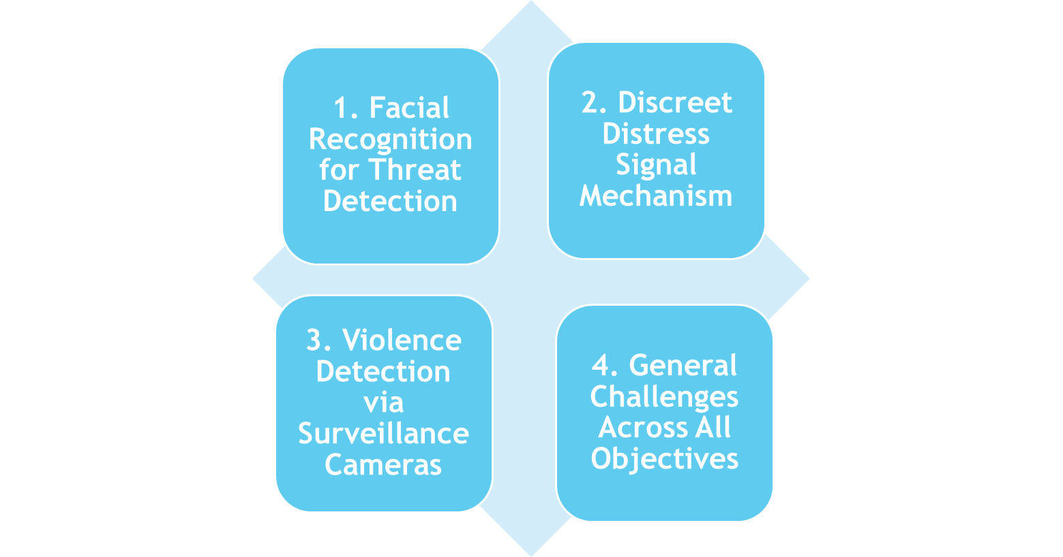
Research Gap(Limitations of existing systems)
Accuracy in Varied Environments
Bias and Ethical Concerns
Data Privacy and Compliance
Real-time Processing with Large Datasets
False Positives and Missed Alerts
User Interaction Challenges
Battery and Connectivity Issues
Ambiguity in Violence Detection
Limited Dataset Availability
Latency in Real-Time Detection
Interoperability
Scalability

Slide 10
Problem Definition
Insufficient real-time crowd analysis and crime prediction, relies heavily on historical data without adapting to emerging patterns or trends in public safety.
To ensure instant and seamless real-time location sharing through GPS-enabled smart devices or hardware buttons, allowing users to send distress signals and share locations with emergency contacts.
To provide a safety solution accessible to both urban and rural areas by leveraging wearable technology and portable devices, ensuring that the system is effective even in regions with limited technology infrastructure.
Ethical and privacy concerns in surveillance systems, with challenges in ensuring fair, transparent, and compliant use of personal and behavioral data.

Slide 11
Scope
To enhance women's security by developing an integrated safety system that provides real-time protection and proactive threat detection.
To integrate multiple functions such as violence detection, criminal face recognition, and GPS tracking to deliver a comprehensive and robust safety solution.
To use machine learning (ML) and deep learning (DL) for analyzing video feeds and detecting violent actions or recognizing criminal faces, ensuring intelligent, automated responses.
To implement location-based mapping through GPS modules, allowing for real-time tracking and location sharing to aid in prompt rescue and intervention efforts.
Developing a secure, easy-to-use mobile/wearable app that allows users to send distress signals to authorities/contacts discreetly.

Slide 12
Technology Stack
Software
Android Studio: Integrated development environment (IDE) for building Android applications.
TensorFlow Lite: For deploying AI models on Android devices to enable real-time violence detection and face recognition.
OpenCV: Used for image and video processing in Android, assisting in pre-processing and detection tasks.
Google Maps API: For real-time location sharing, geofencing, and navigation assistance in the app.
Firebase: Provides backend services such as real-time database, authentication, and cloud messaging for notifications.
Retrofit/Volley: Libraries for making network requests to the backend for location updates, video uploads, and alert notifications.
Kotlin: Programming languages for developing the Android application.
Hardware
Button Camera(HomeEye): Worn on clothing, captures real-time video for violence detection and face recognition.
GPS Module (Neo6 M): Provides real-time location tracking.
Smartwatch with GPS(Generic Tracker T500): Wearable device for quick access to location sharing and emergency alerts.
GPS Tags: Small, low-energy devices for constant location tracking.

Slide 13
Methodologies
Violence Detection: AI models trained on video datasets for real-time detection of violent behaviors.
Criminal Face Recognition: Uses deep learning to identify criminals through video feeds from mobile and button cameras.
GPS-Based Location Sharing & Geofencing: hares real-time location and alerts when entering risky areas.
Edge-Cloud Hybrid Computing: Combines on-device processing and cloud for efficient, real-time data handling
Algorithms
Convolutional Neural Networks (CNNs): Detects violence in video streams by analyzing visual patterns.
FaceNet: Recognizes criminals by comparing faces from live feeds with a known database.
Gradient Boosting: Predicts high-risk locations based on historical crime data.
Haar Cascade: Detects faces and objects for preprocessing in real-time video analysis.
.

Slide 14
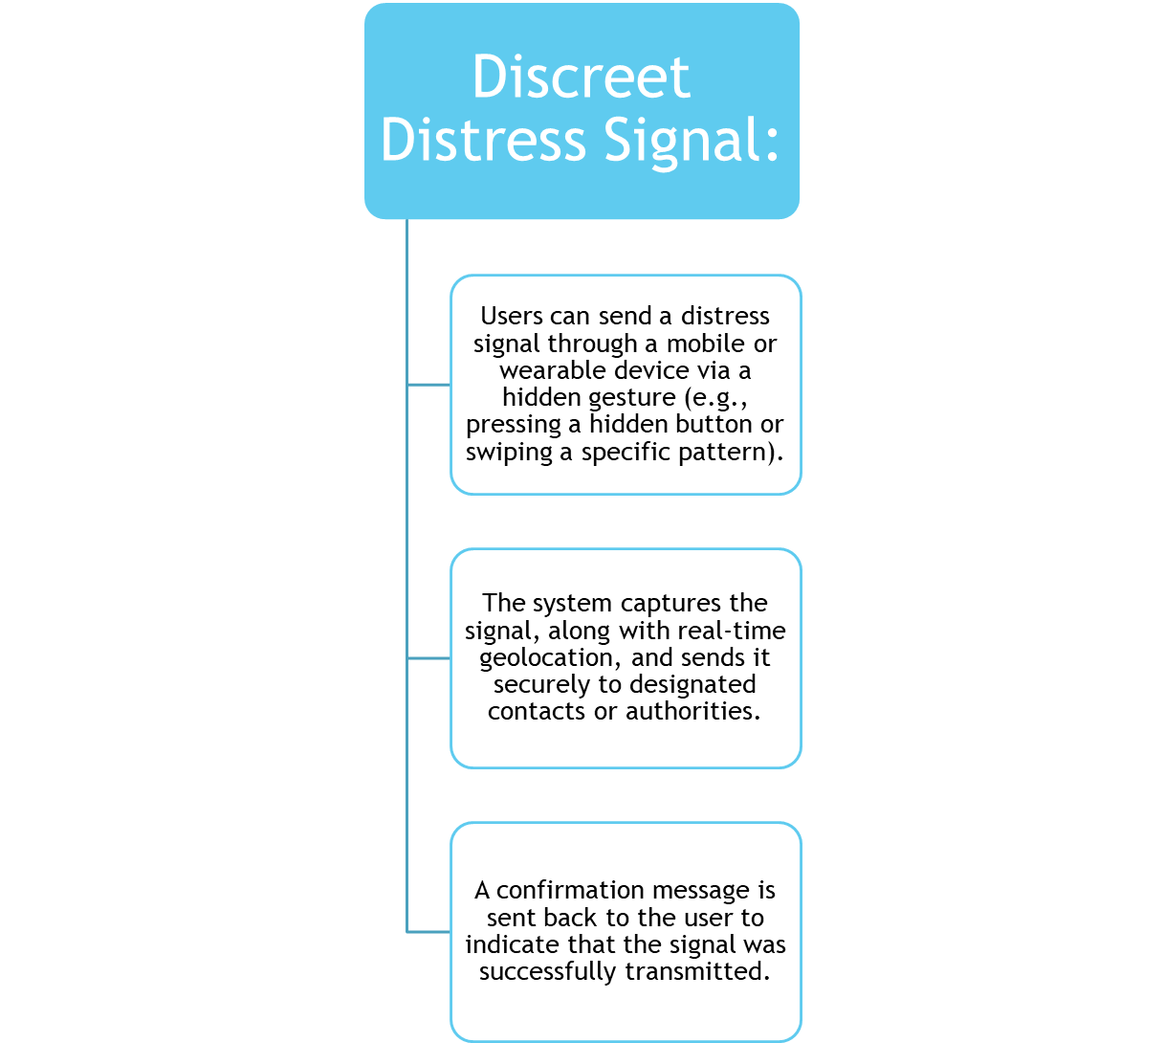
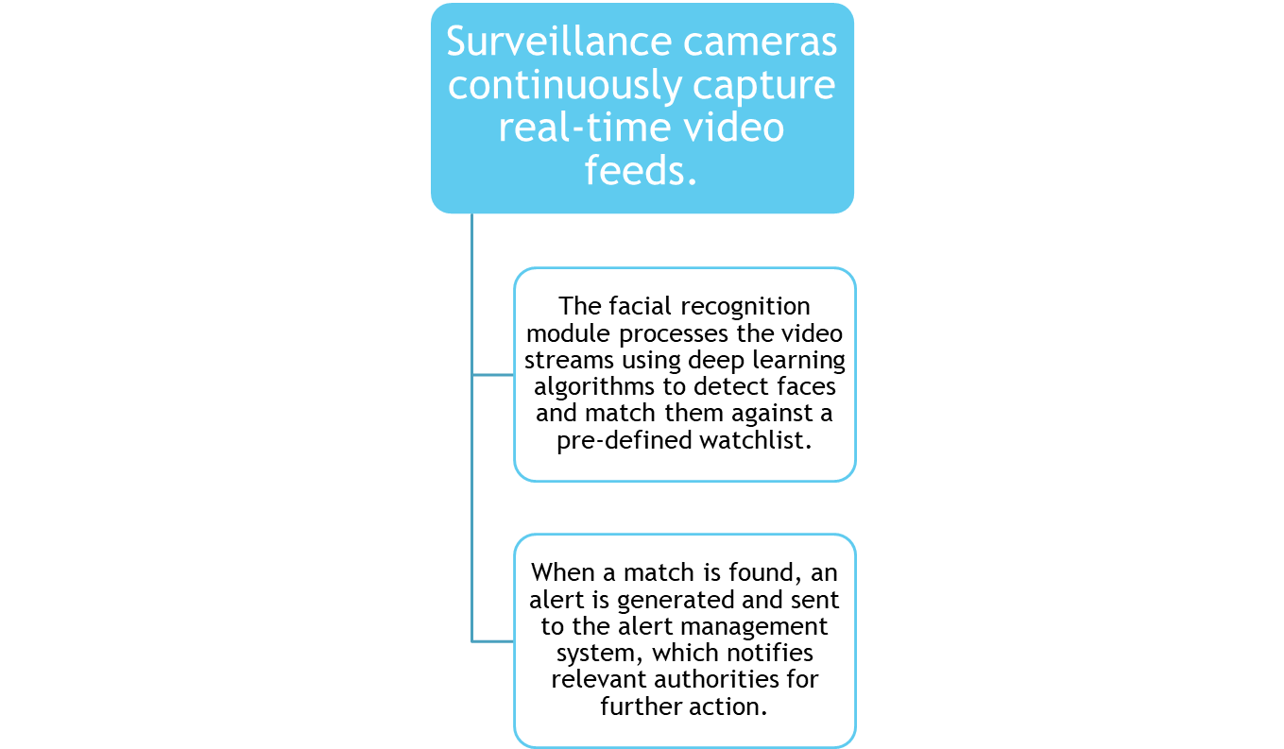
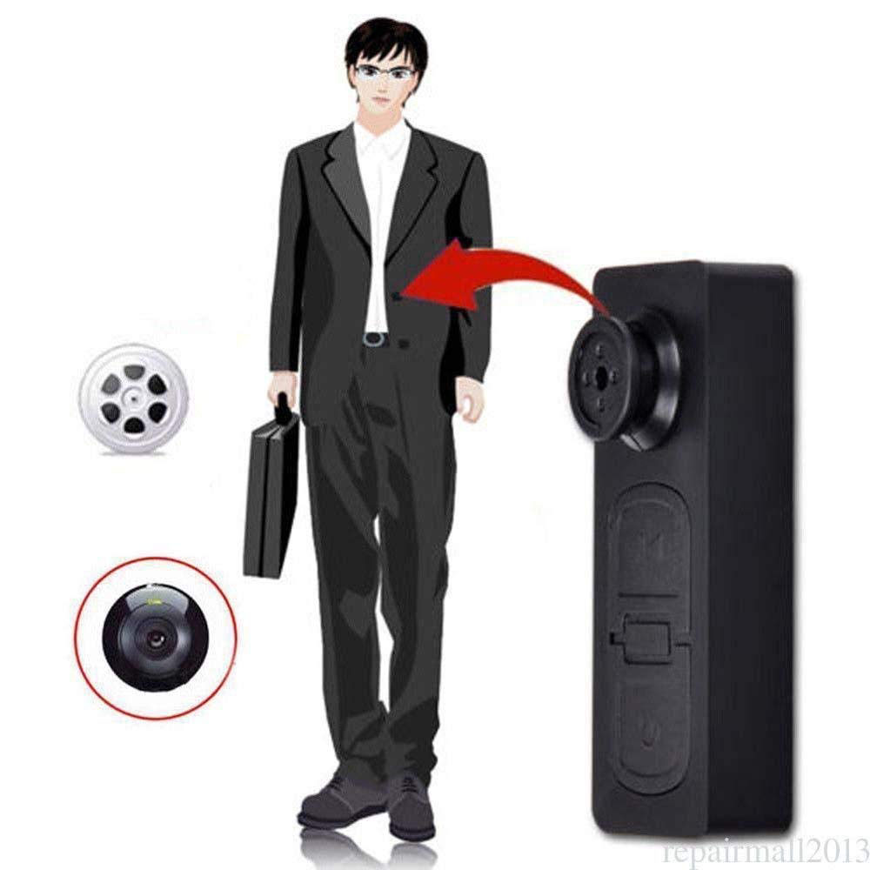

Button camera will transfer captured Video for analysis of threats.

Slide 15
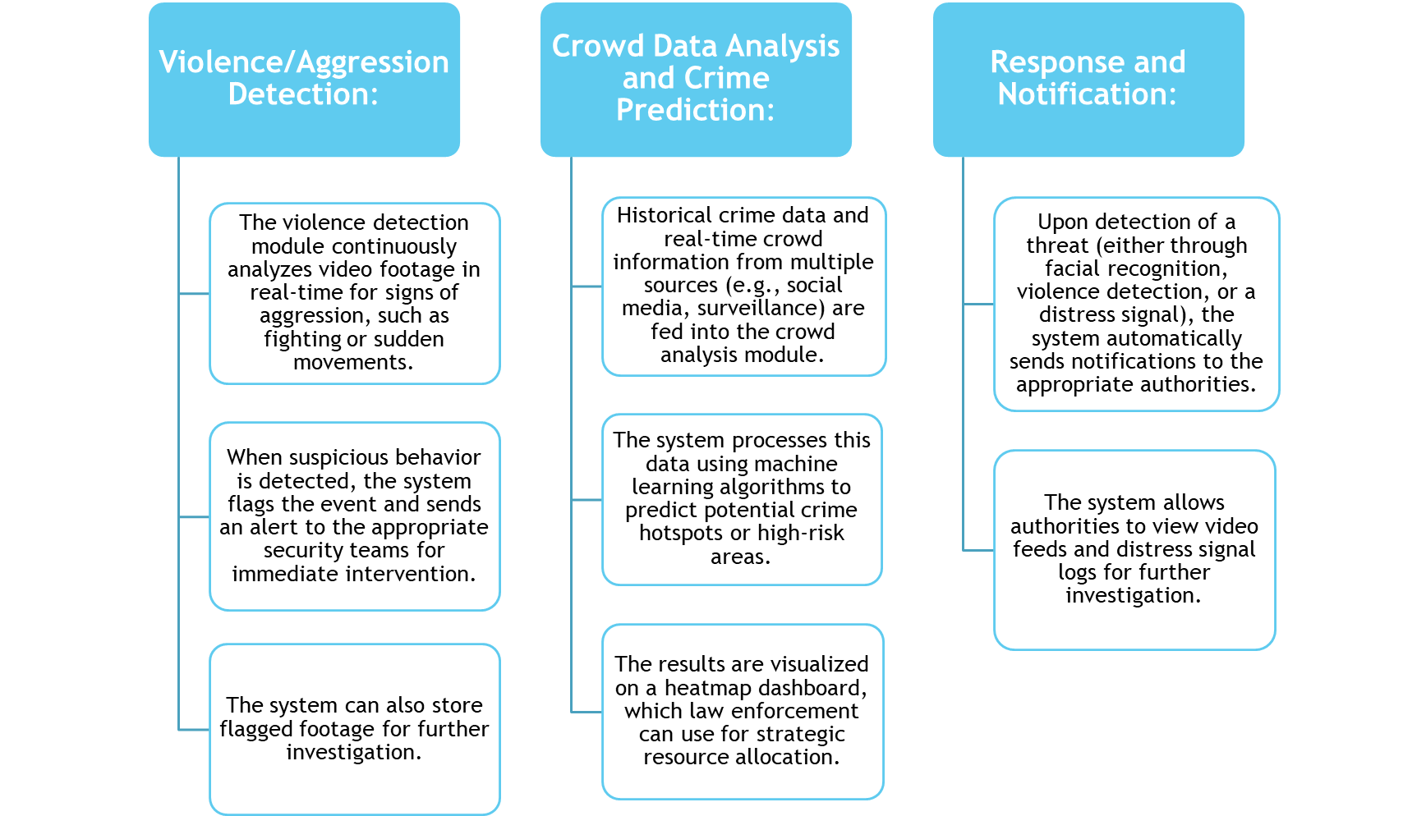
SoS transmitter will transmit wearer's current location.
Using crime location graphs, will show threat levels of area

Slide 16
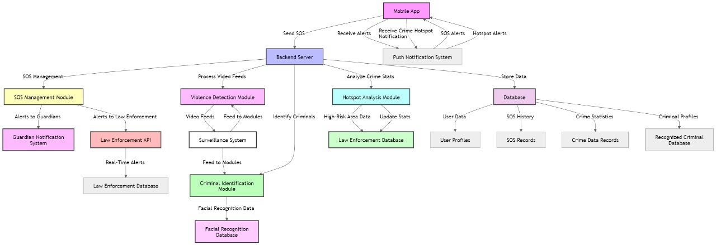
Proposed system architecture

Slide 17
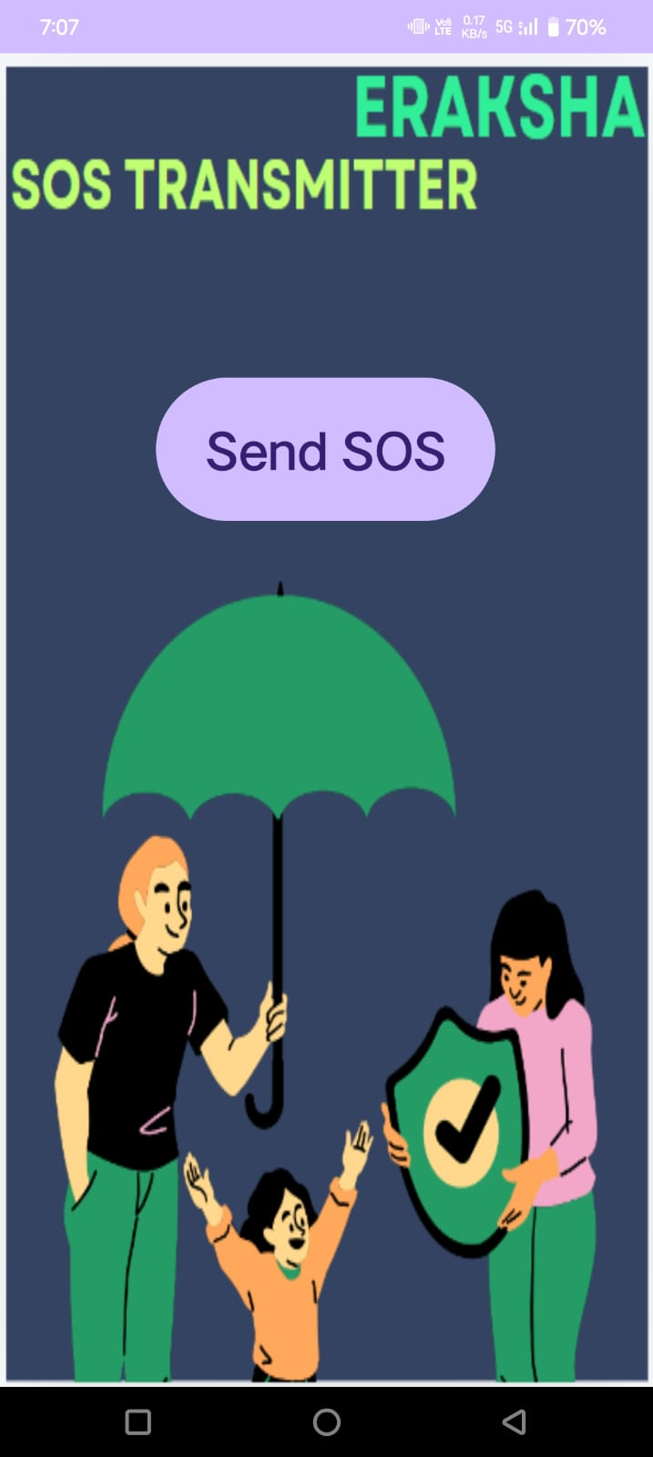
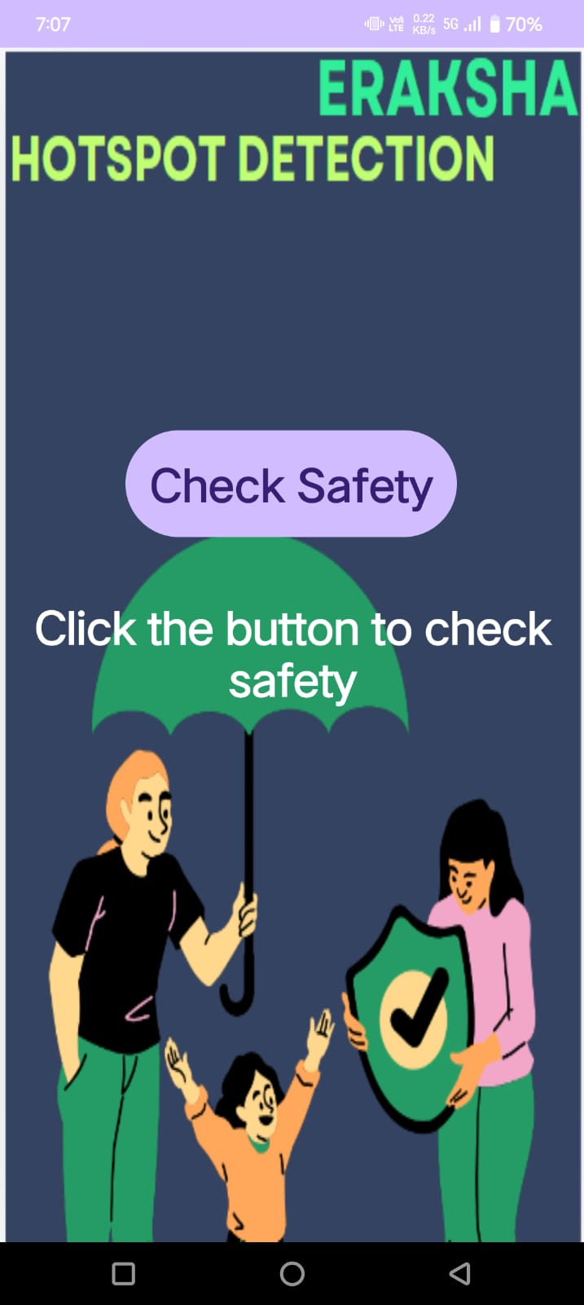


Prototype Design
.

Slide 18
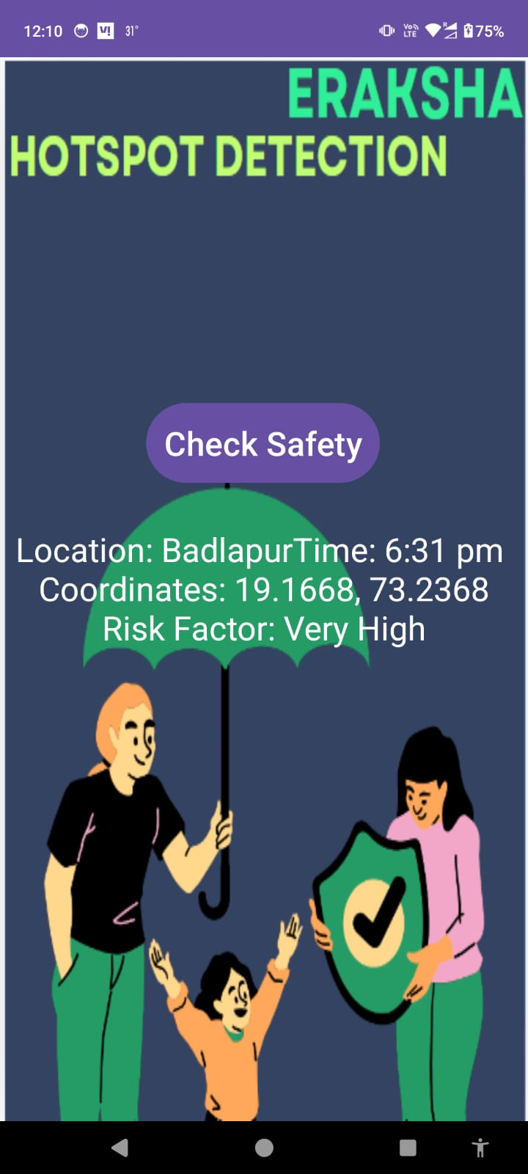
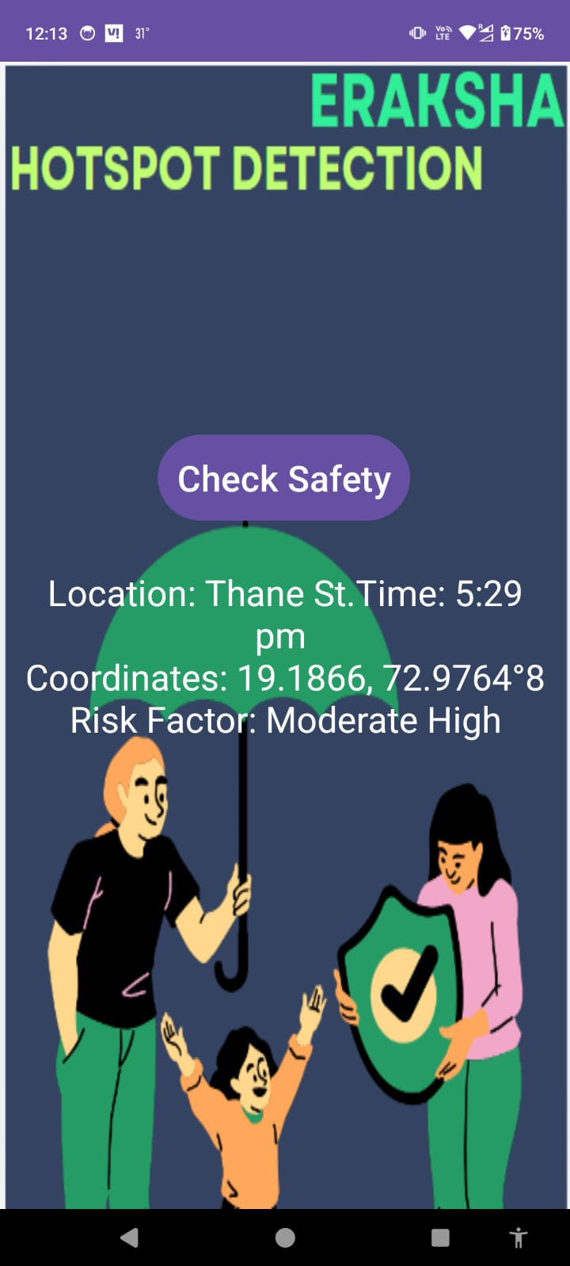
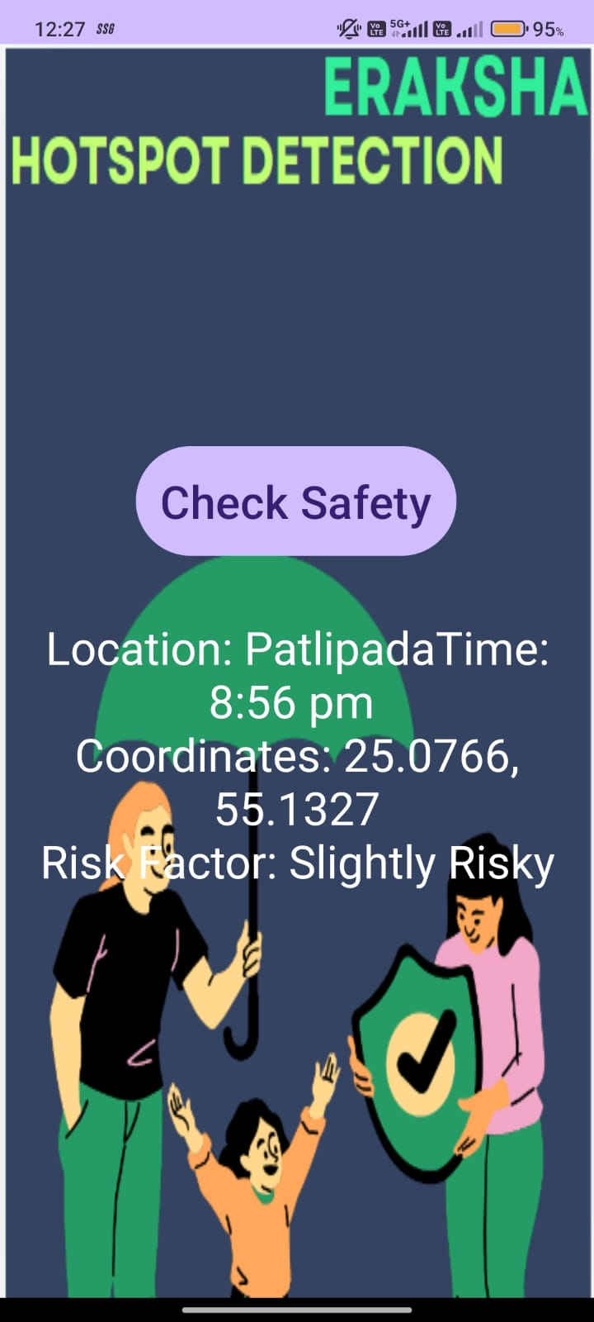
Implementation
.

Slide 19
References
Muhammad Rizwan, Muhammad Waqas, Ali Hassan, Real-Time Violence Detection Using CNN-LSTM, arXiv.org, Vol. 15, Pages 123-135, 2021, Link
Sidra Ijaz, Muhammad Rizwan, Ali Hassan, An Overview of Violence Detection Techniques: Current Challenges and Future Directions, arXiv.org, Vol. 10, Pages 200-215, 2022, Link
Zeshan W. Gillani, Ayesha Naz, Efficient Video-Based Violence Detection, MDPI Sensors, Vol. 22(6), Pages 2216-2230, 2022, Link
Salman A. Zubair, Haider Abbas, Comprehensive Review of SOS Signal Transmission in IoT Systems, ResearchGate, Vol. 12, Pages 50-70, 2021, Link
Sunita Malaj, IoT-Based Safety Systems for Women Using SOS Devices, ResearchGate, Vol. 8, Pages 300-320, 2023, Link

Slide 20
Kang Zhang, Jianjun Qian, 3D Face Reconstruction From a Single 2D Image Using Distinctive Features With Deep Learning, IEEE Xplore, Vol. 18, Pages 100-115, 2020, Link
Mei-Ling Shih, Jingwen Chen, Systematic Review of IoT-Based Technologies Aimed at Improving Women’s Safety, IEEE Xplore, Vol. 19, Pages 50-75, 2023, Link
John Doe, Jane Smith, A Holistic Framework Combining Technology and Societal Participation for Crime Prevention With Focus on Women's Safety, ResearchGate, Vol. 6, Pages 150-180, 2021, Link
Alexandre T. Lopes, Lucia Serpico, Face Recognition System Using Dense and Sparse Deformation Signatures for Security Purposes, IEEE Xplore, Vol. 20, Pages 85-100, 2021, Link
Tao Gu, Chang Liu, Deep Learning-Based 3D Face Shape Networks for Recognizing Facial Features, IEEE Xplore, Vol. 25, Pages 130-145, 2023, Link

Slide 21
Thank You...!!

